Slide 1
Java Server Pages
by Jon Pearce

Slide 2
JSP Documents
JSP docs are XHTML Documents containing:
  Fixed-Template Data: FTD
    HTML Components
    XML markup
  JSP Components: <JSP>

Slide 3
demo.jsp
<?xml version = 1.0?>
<!DOCTYPE html PUBLIC ".../xhtml1-strict.dtd">
<html xmlns = "http://www.w3.org/1999/xhtml">
<head> <title> Demo </title> </head>
<body>
FTD <JSP> FTD <JSP> FTD <JSP>...
</body>
</html>

Slide 4
JSP Components <JSP>
Scriptlets
  <%, <%--, <%=, <%! ... %>
Directives
  <%@ directive %>
Actions
  <jsp: action> ... </jsp:action>
  <myNS:action> ... </myNS:action>

Slide 5
JSP Facts
The container compiles a JSP to a servlet the first time it is served.
Use JSPs when ratio of FTD to Dynamic Content is high
JSPs decouple design from programming
  JSP = HTML containing Java
  Servlet = Java containing HTML
JSPs replace views

Slide 6
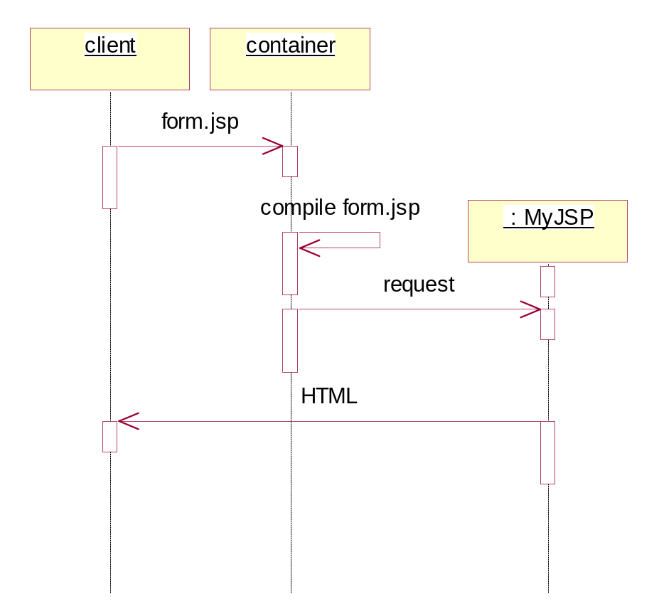
JSP Compilation

Slide 7
Scriptlets
<% (partial) statement %>
<%-- comment --%>
<%! declaration %>
<%= expression %>

Slide 8
Examples of Scripting Components
<%! int counter = 0; %>
counter = <%= counter++ %>
<% if (counter > 5) { counter = 0; } %>
HTML
<% else { counter++; } %>
ALTERNATIVE HTML
<%-- don't read this --%>

Slide 9
Implicit Objects
Application Scope
  application
Session Scope
  session
Request Scope
  request
Page Scope
  response, out, page, pageContext

Slide 10
Example
<%
String name = request.getParameter("name");
if (name != null) {
%>
<p> Hello <%= name %> </p>
<%
} else {
%>
<p> Hello John Doe </p>
<% } %>

Slide 11
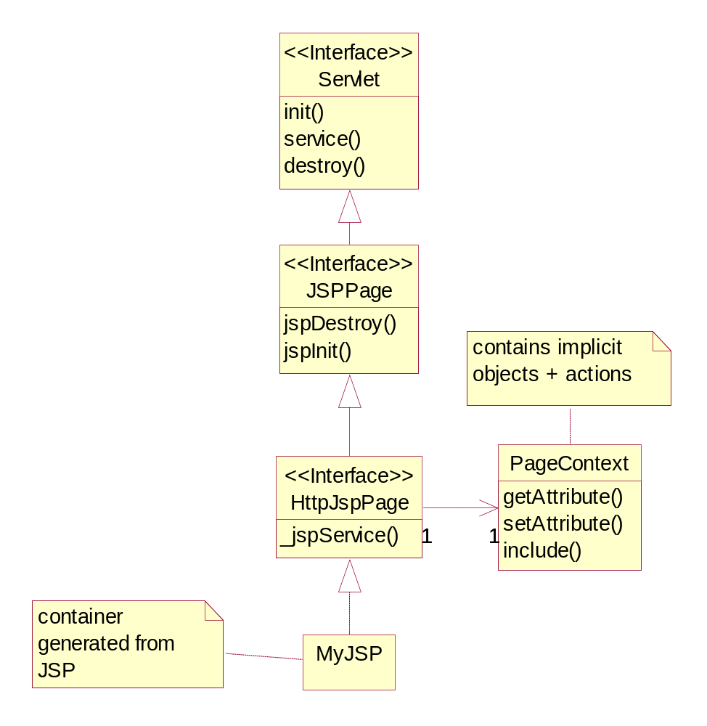
javax.servlet.jsp

Slide 12
The JSP to Servlet Translation
public class MyJSP implements HttpJspPage {
// ...
public void _jspService(HttpServletRequest request, HttpServletResponse response)
throws IOException, ServletException {
JspFactory factory = JspFactory.getDefaultFactory();
PageContext pageContext = factory.getPageContext(...);
HttpSession session = pageContext.getSession();
JspWriter out = pageContext.getOut();
Object page = this;
try {
// body of translated JSP goes here ...
} catch (Exception e) {
out.clear();
pageContext.handlePageException(e);
} finally {
out.close();
factory.releasePageContext(pageContext);
}
}
}

Slide 13
Examples
clock.jsp
  <%= new java.util.Date() %>
scriptTest.jsp
  Pallindrome Tester
beanTest.jsp
  various counters
personView.jsp

Slide 14
Standard Actions
<jsp:action> ... </jsp:action>
include
forward
plugin
param
useBean
setProperty
getProperty

Slide 15
Directives
<%@ include ... %>
<%@ taglib ... %>
<%@ page ... %>
  <%@ page errorPage = "foo.jsp" %>
  <%@ page session = "true" %>
  <%@ page language = "java" %>
  <%@ page extends = "java.awt.Frame" %>
  <%@ page import = "java.util.*" %>

Slide 16
Include Directive
<%@ include file = "banner.html" %>

Slide 17
Include Directive vs. Action
<jsp:include page = "foo.jsp" flush = "true" />
  foo.html included after each change
<%@ include file = "foo.jsp" %>
  foo.html included once at compile time
Static (html) or dynamic (jsp) files can be included

Slide 18
forward
<jsp:forward page = "foo.jsp">
<jsp:param
name = "date"
value = "<%= new Date() %>"
/>
</jsp:forward>

Slide 19
useBean
<jsp:useBean id="cart" scope="session" class = "CartBean" />
Accessing Bean Properties
  <%= cart.getTotal() %>
  <jsp:getProperty name = "cart" property = "total" />
Setting Bean Properties
  <% cart.setTotal(200); %>
  <jsp:setProperty name = "cart" property = "total" value = "200" />

Slide 20
Example
<jsp:useBean id = "helper" scope = "session"
class = "ViewHelper" />
<% String command = request.getParameter("cmmd");
String content = helper.execute(command);
%>
<p> result = <%= content %> </p>

Slide 21
Custom Tag Libraries

